Slide 1

Introduction to Artificial Intelligence
The Fundamentals of Machine Learning

Slide 2

Chapter 0
Introduction to Artificial Intelligence
What is artificial intelligence
AI types
Difference between AI, ML, and DL
Data Roles
AI applications
Companies

Slide 3


What is
AI?
Artificial intelligence (AI) is a wide-ranging branch of computer science concerned with building smart machines capable of performing tasks that typically require human intelligence.

Slide 4
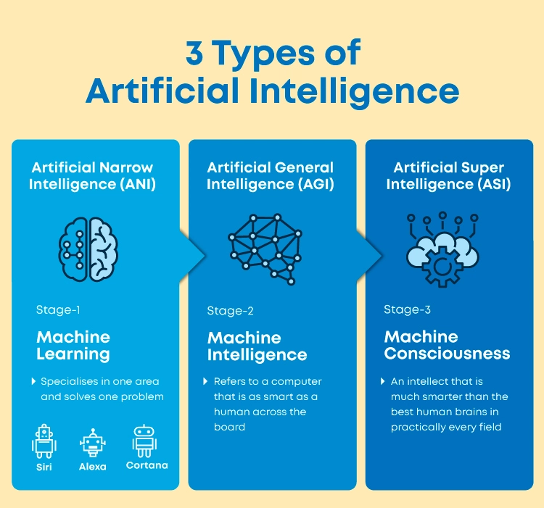

Slide 5
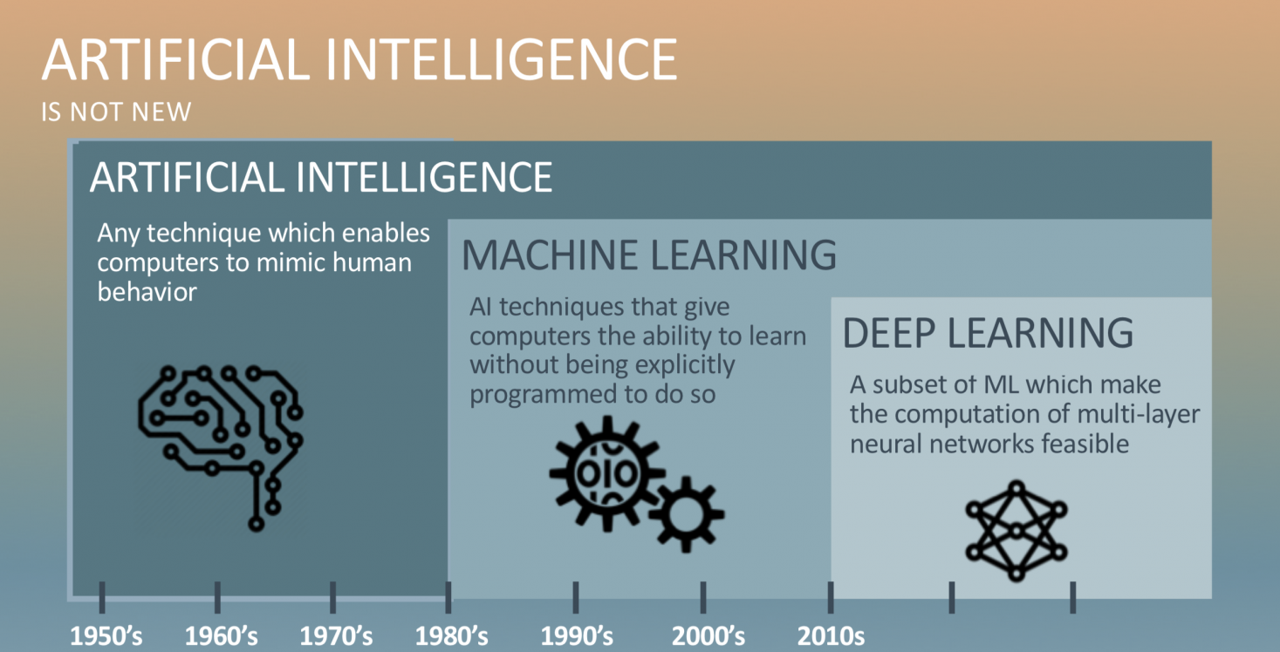

Slide 6

Data Roles
Business Analyst
Data Engineers
Data Analyst
Data Scientist
Machine Learning Engineer
AI researcher

Slide 7
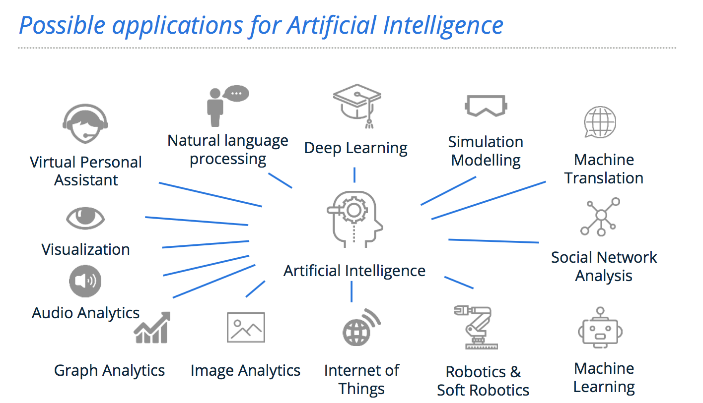

Slide 8


















Companies in Jordan that use AI in their business

Slide 9
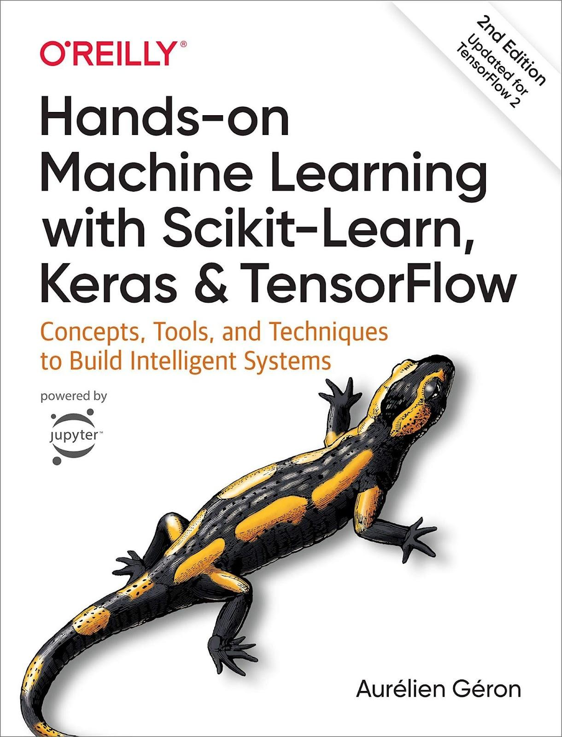

Slide 10
Things to do to get the most benefit from this course
Never miss a lecture
Use notebook
Ask questions
Answer questions
Study at home
Write code by yourself

Slide 11
Introduction to Artificial Intelligence
The Fundamentals of Machine Learning
End-to-End Machine Learning Project
Classification
Training Models
Decision tree

Slide 12
Chapter 1
The Fundamentals of Machine Learning
What is ML
Why use ML
Examples of Applications
Types of ML
Supervised
Unsupervised Learning
Semi Supervised Learning
Self Supervised Learning
Reinforcement Learning
Batch and Online Learning
Main Challenges of Machine Learning
Insufficient Quantity of Training Data
Nonrepresentative Training Data
Poor-Quality Data
Irrelevant Features
Overfitting the Training Data
Underfitting the Training Data
Testing and Validation
Hyperparameter Tuning and Model Selection
Data Mismatch

Slide 13
What Is Machine Learning?
Notes:
Machine Learning is the science (and art) of programming computers so they can learn from data.
Here is a slightly more general definition:
[Machine Learning is the] field of study that gives computers the ability to learn without being explicitly programmed.

Slide 14
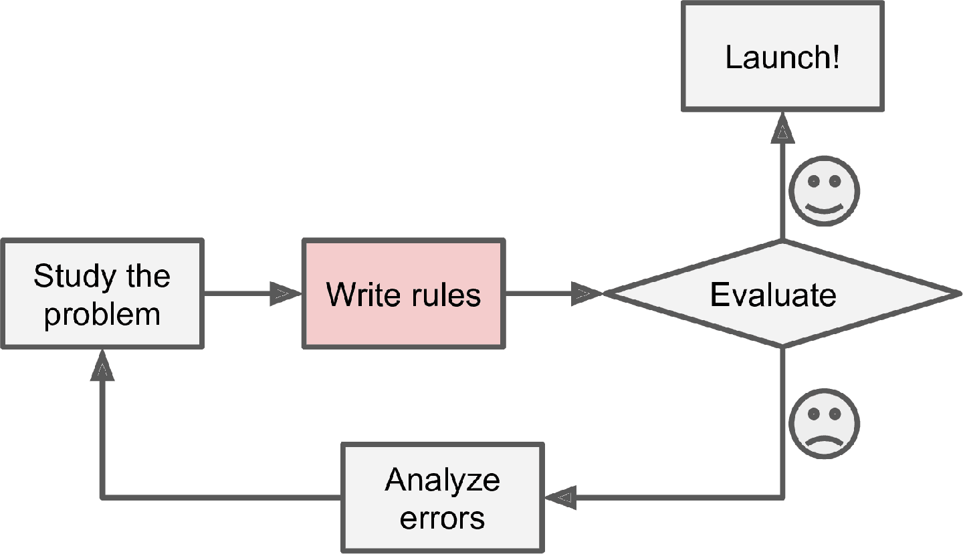
Spam filter
Notes:
Consider how you would write a spam filter using traditional programming techniques:
First you would consider what spam typically looks like. You might notice that some words or phrases (such as “4U,” “credit card,” “free,” and “amazing”) tend to come up a lot in the subject line. Perhaps you would also notice a few other patterns in the sender’s name, the email’s body, and other parts of the email.
You would write a detection algorithm for each of the patterns that you noticed, and your program would flag emails as spam if a number of these patterns were detected.
You would test your program and repeat steps 1 and 2 until it was good enough to launch.
Since the problem is difficult, your program will likely become a long list of complex rules—pretty hard to maintain.
What if spammers notice that all their emails containing “4U” are blocked? They might start writing “For U” instead. A spam filter using traditional programming techniques would need to be updated to flag “For U” emails. If spammers keep working around your spam filter, you will need to keep writing new rules forever.

Slide 15
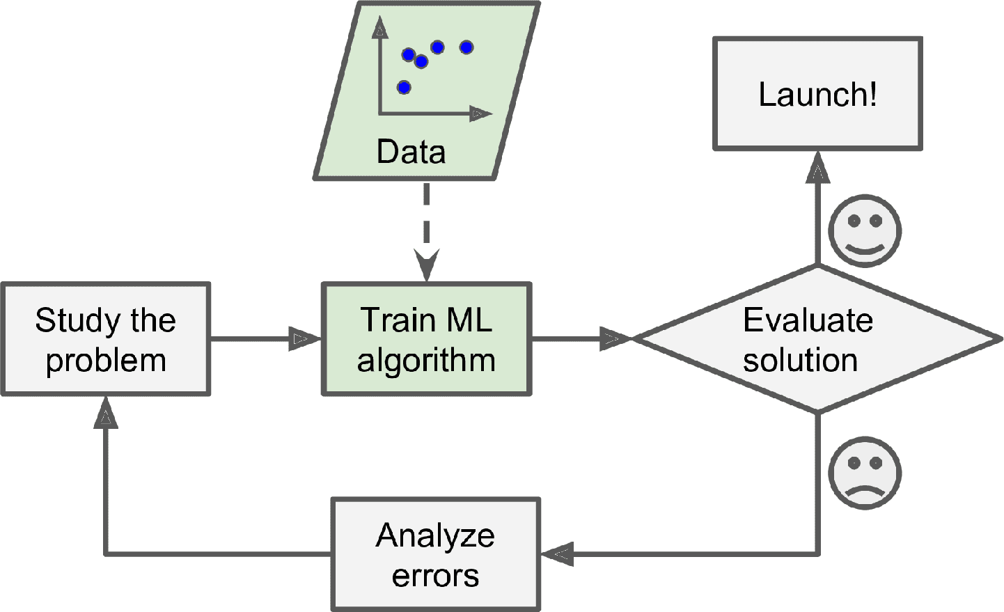
Why Use Machine Learning?
Notes:
In contrast, a spam filter based on Machine Learning techniques automatically learns which words and phrases are good predictors of spam by detecting unusually frequent patterns of words in the spam examples compared to the ham examples. The program is much shorter, easier to maintain, and most likely more accurate.

Slide 16
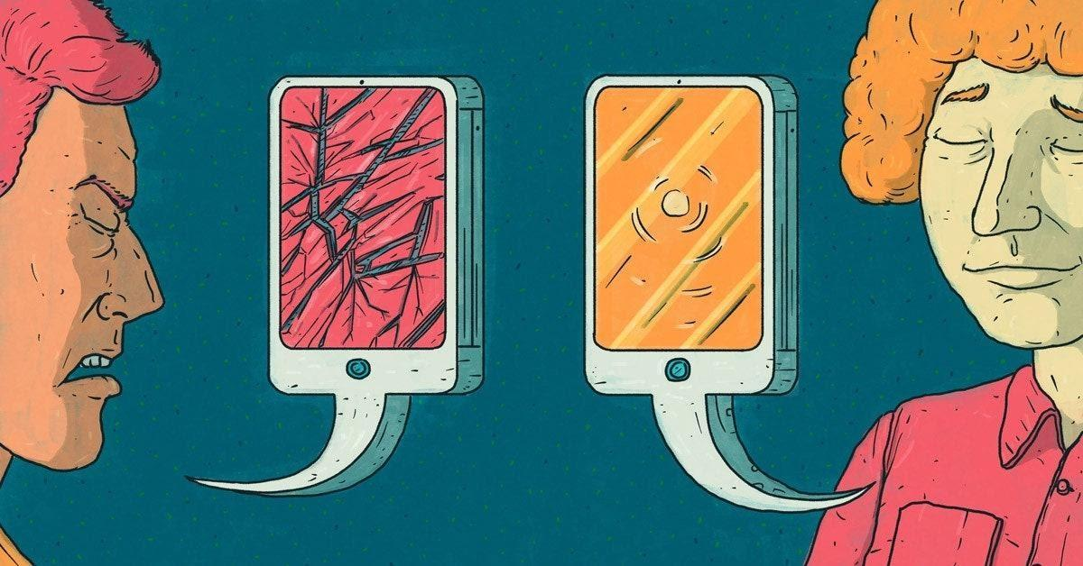
Complex problems
Notes:
Another area where Machine Learning shines is for problems that either are too complex for traditional approaches or have no known algorithm. For example, consider speech recognition. Say you want to start simple and write a program capable of distinguishing the words “one” and “two.” You might notice that the word “two” starts with a high-pitch sound (“T”), so you could hardcode an algorithm that measures high-pitch sound intensity and use that to distinguish ones and twos⁠—but obviously this technique will not scale to thousands of words spoken by millions of very different people in noisy environments and in dozens of languages. The best solution (at least today) is to write an algorithm that learns by itself, given many example recordings for each word.

Slide 17

Notes:
Finally, Machine Learning can help humans learn. ML algorithms can be inspected to see what they have learned (although for some algorithms this can be tricky). For instance, once a spam filter has been trained on enough spam, it can easily be inspected to reveal the list of words and combinations of words that it believes are the best predictors of spam. Sometimes this will reveal unsuspected correlations or new trends, and thereby lead to a better understanding of the problem. Applying ML techniques to dig into large amounts of data can help discover patterns that were not immediately apparent. This is called data mining.

Slide 18
To summarize, Machine Learning is great for:
Problems for which existing solutions require a lot of fine-tuning or long lists of rules: one Machine Learning algorithm can often simplify code and perform better than the traditional approach.
Complex problems for which using a traditional approach yields no good solution: the best Machine Learning techniques can perhaps find a solution.
Fluctuating environments: a Machine Learning system can adapt to new data.
Getting insights about complex problems and large amounts of data.

Slide 19
Detecting tumors
01
Flagging offensive comments
02
Segmenting Clients
Examples of AI Applications
04
Chatbots and personal assistant
03
05
Recommending a product
Intelligent bot
06
Semantic segmentation
Text classification, using NLP tools
Clustering
Many NLP components, including NLU
Recommender system
Reinforcement Learning
Notes:
Detecting tumors in brain scans
This is semantic segmentation, where each pixel in the image is classified (as we want to determine the exact location and shape of tumors), typically using CNNs as well.
Automatically flagging offensive comments
This is also text classification, using the same NLP tools.
Creating a chatbot or a personal assistant
This involves many NLP components, including natural language understanding (NLU) and question-answering modules.
Segmenting clients based on their purchases so that you can design a different marketing strategy for each segment
This is clustering.
Recommending a product that a client may be interested in, based on past purchases
This is a recommender system. One approach is to feed past purchases (and other information about the client) to an artificial neural network, and get it to output the most likely next purchase. This neural net would typically be trained on past sequences of purchases across all clients.
Building an intelligent bot for a game
This is often tackled using Reinforcement Learning, which is a branch of Machine Learning that trains agents (such as bots) to pick the actions that will maximize their rewards over time (e.g., a bot may get a reward every time the player loses some life points), within a given environment (such as the game). The famous AlphaGo program that beat the world champion at the game of Go was built using RL.
This list could go on and on, but hopefully it gives you a sense of the incredible breadth and complexity of the tasks that Machine Learning can tackle, and the types of techniques that you would use for each task.

Slide 20
Types of Machine Learning
Supervised Learning
Unsupervised Learning
Semi Supervised Learning
Self Supervised Learning
Reinforcement Learning

Slide 21
01
Supervised Learning

Slide 22
In supervised learning, the training set you feed to the algorithm includes the desired solutions, called labels

Slide 23
Supervised
Regression
classification
Notes:
A typical supervised learning task is classification. The spam filter is a good example of this: it is trained with many example emails along with their class (spam or ham), and it must learn how to classify new emails.
Another typical task is to predict a target numeric value, such as the price of a car, given a set of features (mileage, age, brand, etc.) called predictors. This sort of task is called regression.1 To train the system, you need to give it many examples of cars, including both their predictors and their labels (i.e., their prices).
Note that some regression algorithms can be used for classification as well, and vice versa. For example, Logistic Regression is commonly used for classification, as it can output a value that corresponds to the probability of belonging to a given class (e.g., 20% chance of being spam).

Slide 24
Some of the most important supervised learning algorithms
k-Nearest Neighbors
Linear Regression
Logistic Regression
Support Vector Machines (SVMs)
Decision Trees and Random Forests
Neural networks

Slide 25
02
Unsupervised learning

Slide 26
Some of the most important unsupervised learning algorithms
Clustering
K-Means
DBSCAN
Hierarchical Cluster Analysis (HCA)
Anomaly detection and novelty detection
One-class SVM
Isolation Forest
Visualization and dimensionality reduction
Principal Component Analysis (PCA)
Kernel PCA
Locally Linear Embedding (LLE)
t-Distributed Stochastic Neighbor Embedding (t-SNE)

Slide 27
03
Semi Supervised learning

Slide 28
04
Self Supervised learning

Slide 29
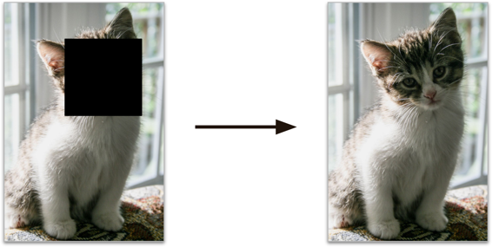
Notes:
Another approach to Machine Learning involves actually generating a fully labeled dataset from a fully unlabeled one. Again, once the whole dataset it labeled, any supervised learning algorithm can be used. This approach is called self-supervised learning.

Slide 30
05
Reinforcement learning

Slide 31
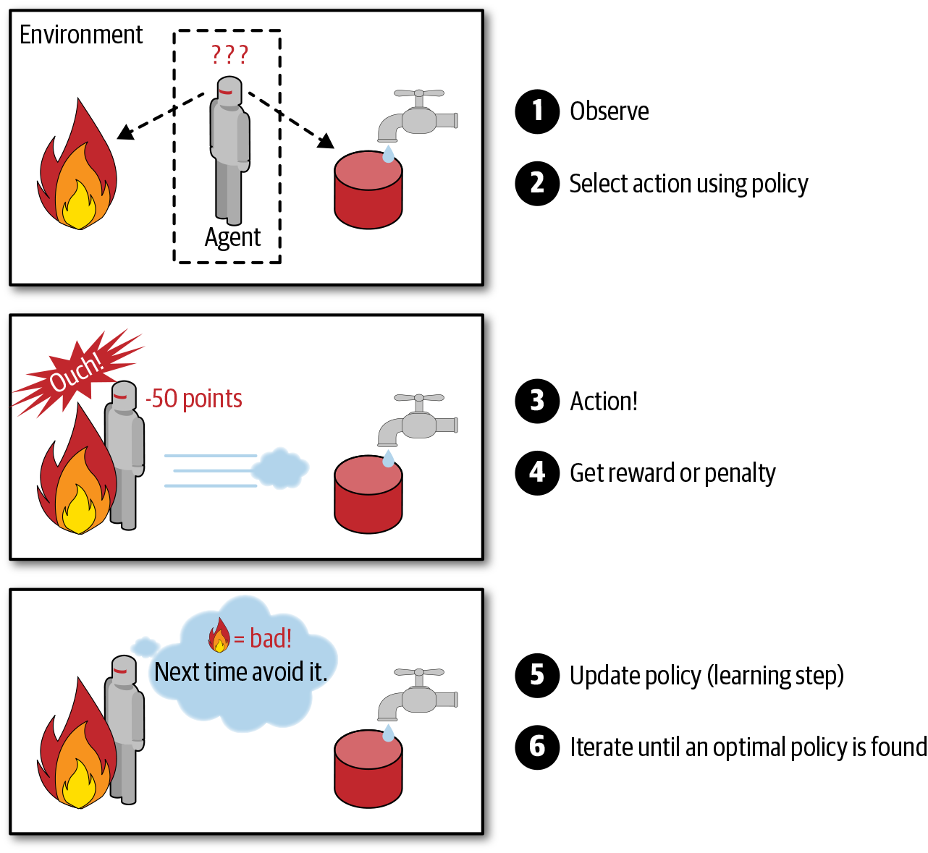

Slide 32
Batch and Online Learning
Another criterion used to classify Machine Learning systems is whether or not the system can learn incrementally from a stream of incoming data.
Batch learning
In batch learning, the system is incapable of learning incrementally: it must be trained using all the available data. This will generally take a lot of time and computing resources, so it is typically done offline. First the system is trained, and then it is launched into production and runs without learning anymore; it just applies what it has learned. This is called offline learning.
Online learning
In online learning, you train the system incrementally by feeding it data instances sequentially, either individually or in small groups called mini-batches. Each learning step is fast and cheap, so the system can learn about new data on the fly, as it arrives

Slide 33
Main Challenges of Machine Learning
Insufficient Quantity of Training Data
Nonrepresentative Training Data
Poor-Quality Data
Irrelevant Features
Overfitting the Training Data
Underfitting the Training Data

Slide 34
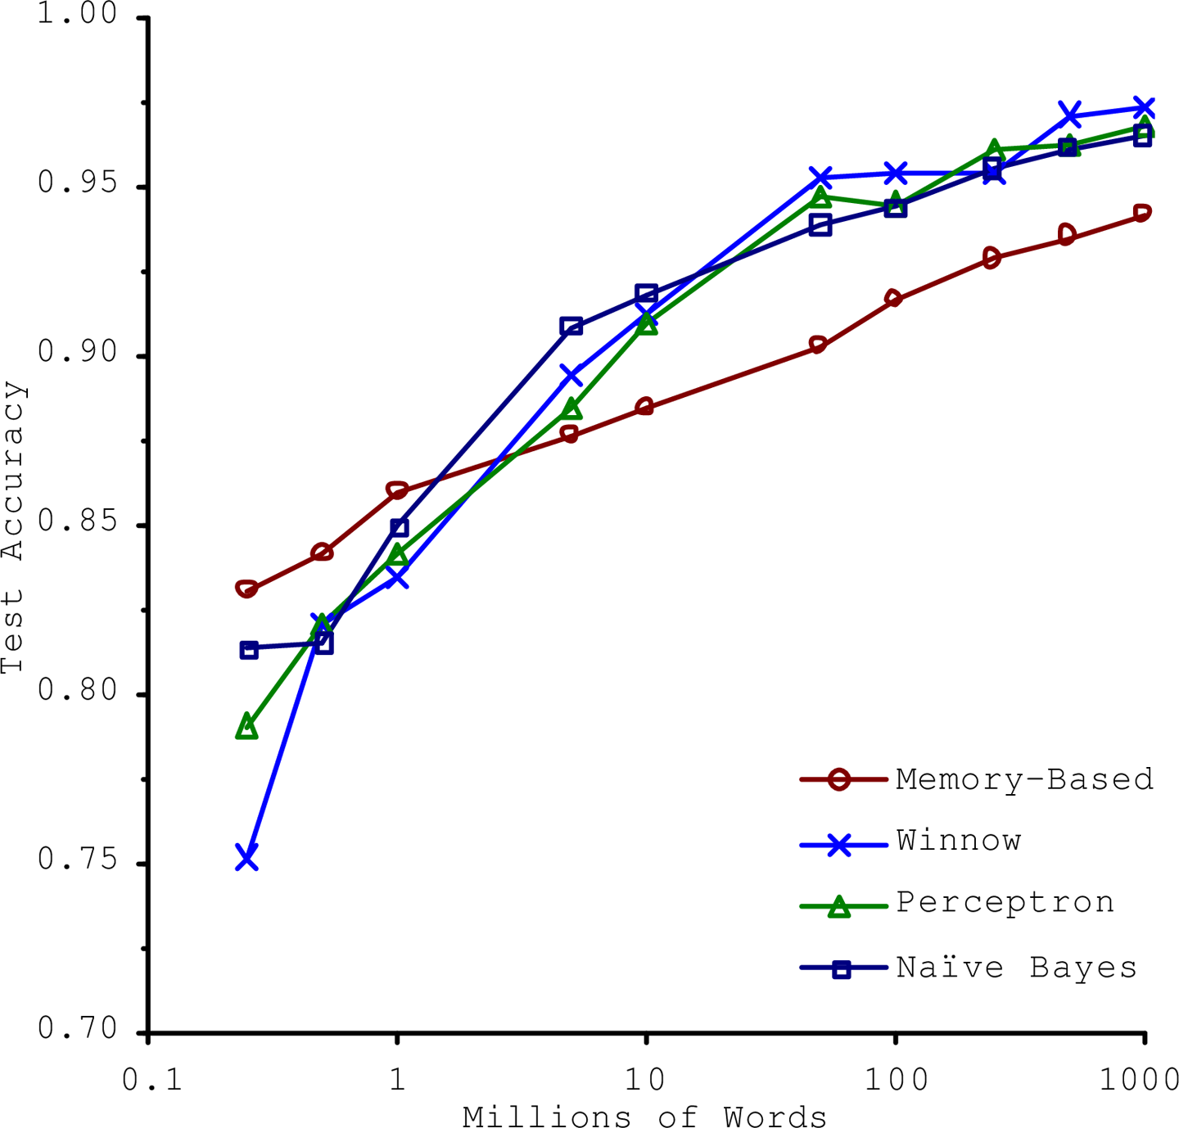
Insufficient Quantity of Training Data

Slide 35
Learning style
Instance-Based
Model-Based Learning
Possibly the most trivial form of learning is simply to learn by heart. If you were to create a spam filter this way, it would just flag all emails that are identical to emails that have already been flagged by users—not the worst solution, but certainly not the best
Another way to generalize from a set of examples is to build a model of these exam‐ ples and then use that model to make predictions

Slide 36
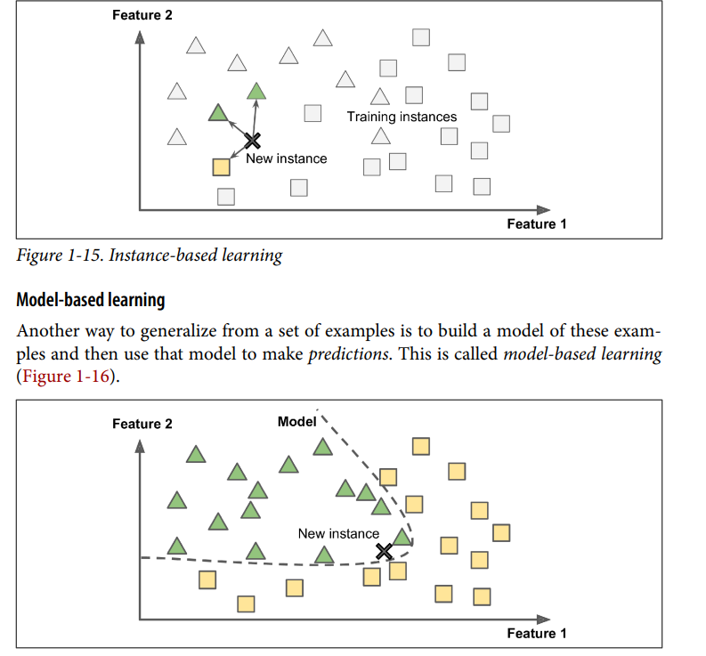

Slide 37
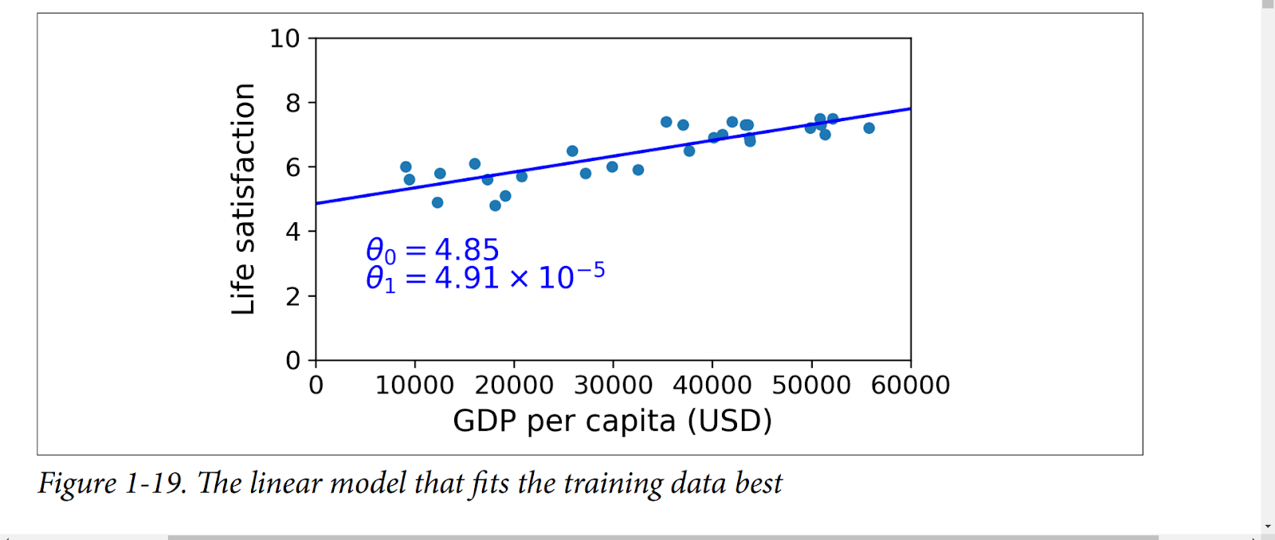
Linear model

Slide 38
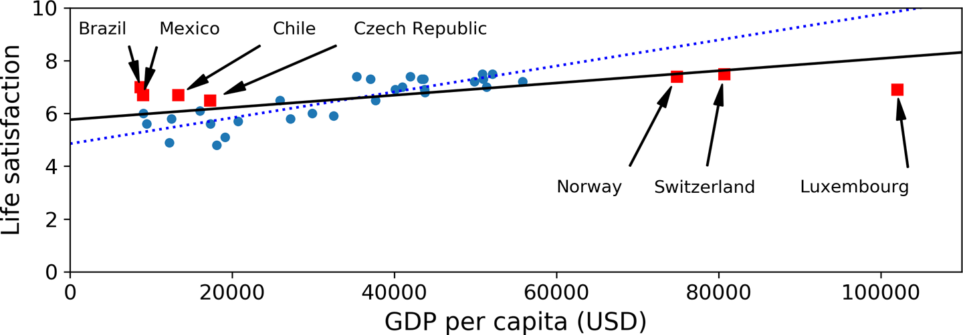
Nonrepresentative Training Data

Slide 39
Poor-Quality Data
If some instances are clearly outliers, it may help to simply discard them or try to fix the errors manually.
If some instances are missing a few features (e.g., 5% of your customers did not specify their age), you must decide whether you want to ignore this attribute altogether, ignore these instances, fill in the missing values (e.g., with the median age), or train one model with the feature and one model without it.

Slide 40
Irrelevant Features
Feature selection (selecting the most useful features to train on among existing features)
Feature extraction (combining existing features to produce a more useful one⁠—as we saw earlier, dimensionality reduction algorithms can help)
Creating new features by gathering new data

Slide 41
There’s just one last important topic to cover: once you have trained a model, you don’t want to just “hope” it generalizes to new cases. You want to evaluate it and fine-tune it if necessary. Let’s see how to do that

Slide 42
Testing and Validating
The only way to know how well a model will generalize to new cases is to actually try it out on new cases. One way to do that is to put your model in production and monitor how well it performs. This works well, but if your model is horribly bad, your users will complain—not the best idea.
A better option is to split your data into two sets: the training set and the test set. You train your model using the training set, and you test it using the test set. The error rate on new cases is called the generalization error (or out-of-sample error), and by evaluating your model on the test set, you get an estimate of this error. This value tells you how well your model will perform on instances it has never seen before.
If the training error is low (i.e., your model makes few mistakes on the training set) but the generalization error is high, it means that your model is overfitting the training data

Slide 43
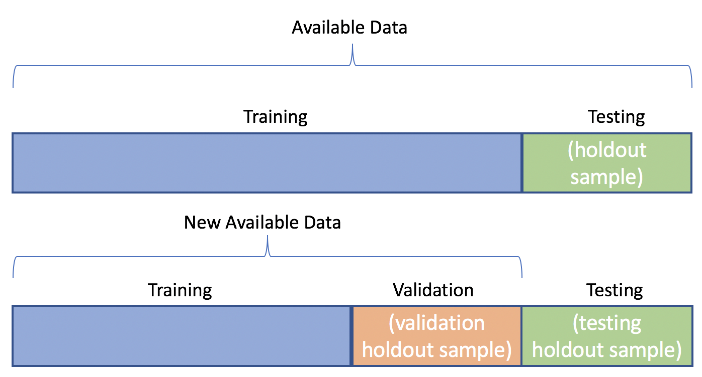
Hyperparameter Tuning and Model Selection
Notes:
Evaluating a model is simple enough: just use a test set. But suppose you are hesitating between two types of models (say, a linear model and a polynomial model): how can you decide between them? One option is to train both and compare how well they generalize using the test set.
Now suppose that the linear model generalizes better, but you want to apply some regularization to avoid overfitting. The question is, how do you choose the value of the regularization hyperparameter? One option is to train 100 different models using 100 different values for this hyperparameter. Suppose you find the best hyperparameter value that produces a model with the lowest generalization error⁠—say, just 5% error. You launch this model into production, but unfortunately it does not perform as well as expected and produces 15% errors. What just happened?
The problem is that you measured the generalization error multiple times on the test set, and you adapted the model and hyperparameters to produce the best model for that particular set. This means that the model is unlikely to perform as well on new data.
A common solution to this problem is called holdout validation: you simply hold out part of the training set to evaluate several candidate models and select the best one. The new held-out set is called the validation set. More specifically, you train multiple models with various hyperparameters on the reduced training set (i.e., the full training set minus the validation set), and you select the model that performs best on the validation set. After this holdout validation process, you train the best model on the full training set (including the validation set), and this gives you the final model. Lastly, you evaluate this final model on the test set to get an estimate of the generalization error.

Slide 44
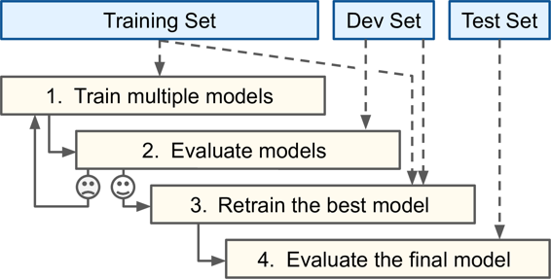

Slide 45
Problems with Validation set
Too Big
Too Small
Cross Validation
Notes:
This solution usually works quite well. However, if the validation set is too small, then model evaluations will be imprecise: you may end up selecting a suboptimal model by mistake. Conversely, if the validation set is too large, then the remaining training set will be much smaller than the full training set. Why is this bad? Well, since the final model will be trained on the full training set, it is not ideal to compare candidate models trained on a much smaller training set.

Slide 46
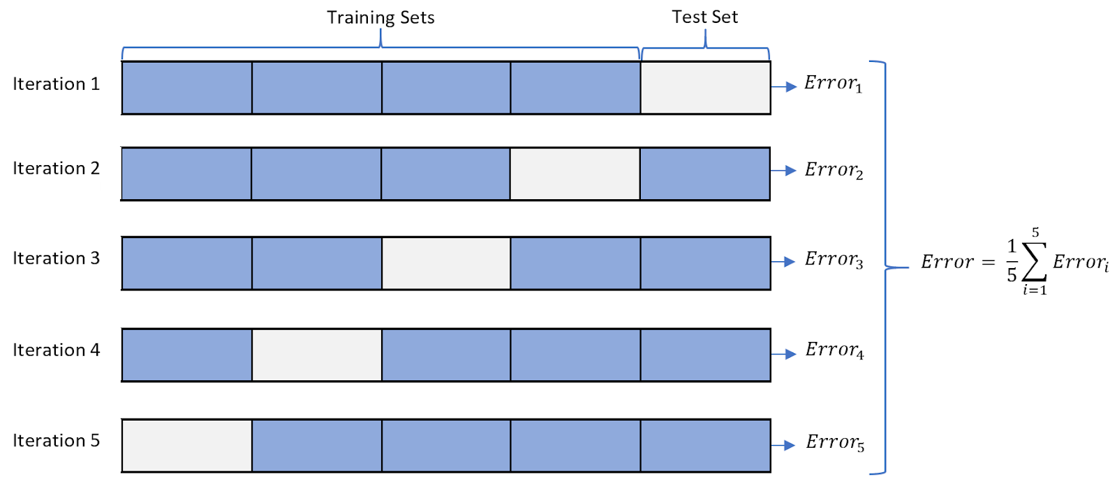
Cross-Validation
Notes:
One way to solve this problem is to perform repeated cross-validation, using many small validation sets. Each model is evaluated once per validation set after it is trained on the rest of the data. By averaging out all the evaluations of a model, you get a much more accurate measure of its performance. There is a drawback, however: the training time is multiplied by the number of validation sets.

Slide 47
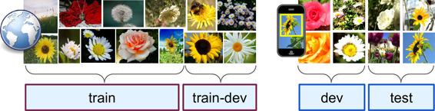
Notes:
In some cases, it’s easy to get a large amount of data for training, but this data probably won’t be perfectly representative of the data that will be used in production. For example, suppose you want to create a mobile app to take pictures of flowers and automatically determine their species. You can easily download millions of pictures of flowers on the web, but they won’t be perfectly representative of the pictures that will actually be taken using the app on a mobile device.
Perhaps you only have 10,000 representative pictures (i.e., actually taken with the app). In this case, the most important rule to remember is that the validation set and the test set must be as representative as possible of the data you expect to use in production, so they should be composed exclusively of representative pictures: you can shuffle them and put half in the validation set and half in the test set (making sure that no duplicates or near-duplicates end up in both sets).
But after training your model on the web pictures, if you observe that the performance of the model on the validation set is disappointing, you will not know whether this is because your model has overfit the training set, or whether this is just due to the mismatch between the web pictures and the mobile app pictures. One solution is to hold out some of the training pictures (from the web) in yet another set that Andrew Ng calls the train-dev set. After the model is trained (on the training set, not on the train-dev set), you can evaluate it on the train-dev set. If it performs well, then the model is not overfitting the training set.
If it performs poorly on the validation set, the problem must be coming from the data mismatch. You can try to tackle this problem by preprocessing the web images to make them look more like the pictures that will be taken by the mobile app, and then retraining the model. Conversely, if the model performs poorly on the train-dev set, then it must have overfit the training set, so you should try to simplify or regularize the model, get more training data, and clean up the training data.

Slide 48
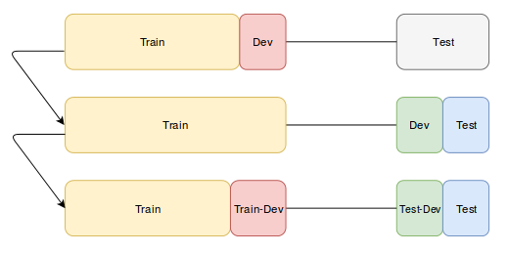
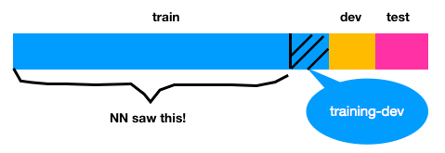
Data Mismatch

Slide 49
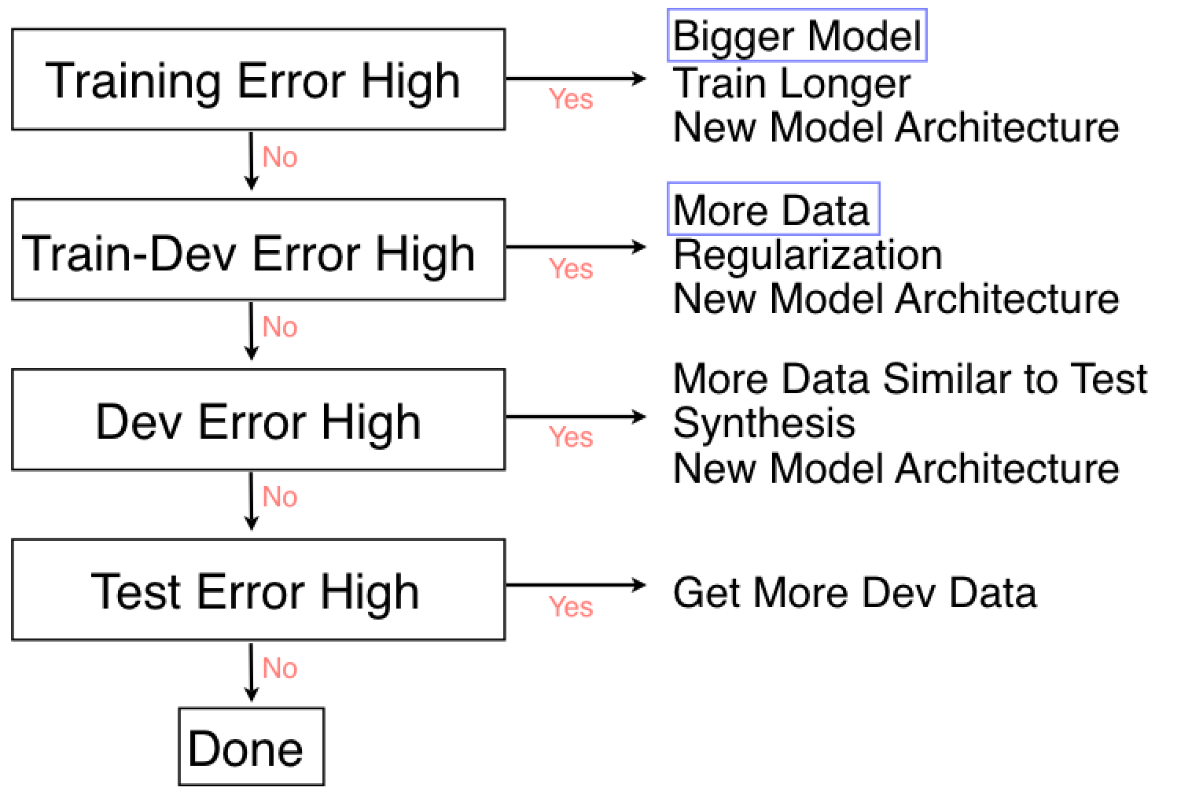
—------------------------------------------------------------------------------------------------------------------------------------------------------------------------------------------------------------------------------------------------------------------
—------------------------------------------------------------------------------------------------------------------------------------------------------------------------------------------------------------------------------------------------------------------
—------------------------------------------------------------------------------------------------------------------------------------------------------------------------------------------------------------------
—--------------------------------------------------------------------
—--------------------------------------------------

Slide 50
Is it possible to have a higher train error than a test error in machine learning? And why is that?

Slide 51
Questions?

